Slide 1

LOAN APPROVAL PREDICATION
Team Name: Group 8
Presented by:
Priyanka Ghadge
Jagath
Harikrishna Thokala
Vijayakumara g
Mentor :
Mr. PARTH
Date : 12/03/2021
DATA SCIENCE

Slide 2
Business Problem:
Loans are one of the core Businesses of bank as lot of profit is gained through loans interests. Loan eligibility is decided after long and intensive verification of the documents and validation of set of criterias which would take huge amount of time and work. So this time consuming process can be reduced by developing a ML model which can predict loan eligibility.
So this ML project aims to create a model that will classify how much loan the user can obtain based on various factors such as the user’s marital status, income, education, employment prospects, number of dependents, etc.
Objective:
Our main object is to predict bank loan eligibility of the customer
/03/2021
DATA SCIENCE

Slide 3
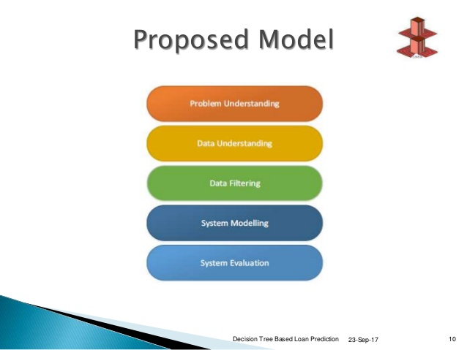
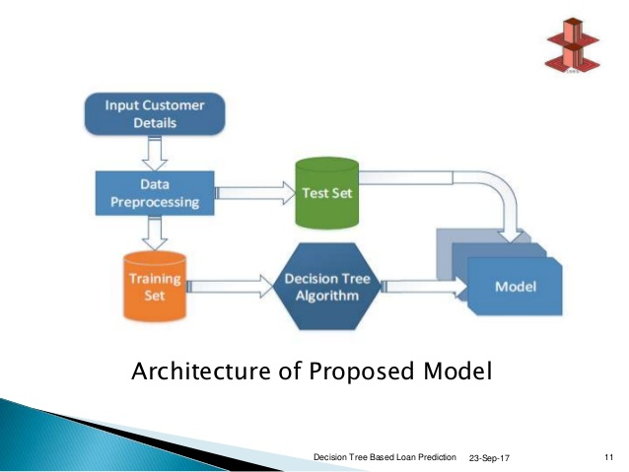
Project Architecture / Project Flow:
DATA SCIENCE

Slide 4
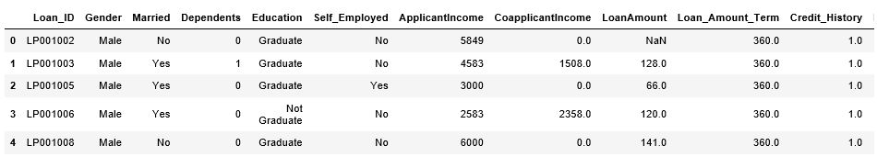
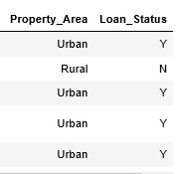
Data set details
Train Dataset:
Total rows(instances)= 614t
Total columns(attributes)= 13
Total number of duplicates= 0
e
: 1T2/03/2021
DATA SCIENCE

Slide 5
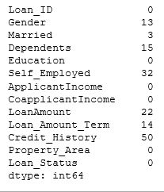
Data set details
Missing values:
Total number of missing values: 149
DATA SCIENCE

Slide 6
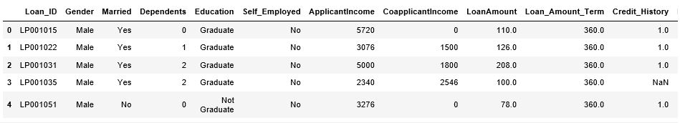
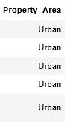
Data set details
Test Dataset:
Total rows(instances)= 367
Total columns(attributes)= 12
e
: 1T2/03/2021
DATA SCIENCE

Slide 7
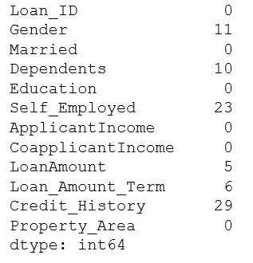
Data set details
Test Missing values:
Total number of missing values: 84
DATA SCIENCE

Slide 8
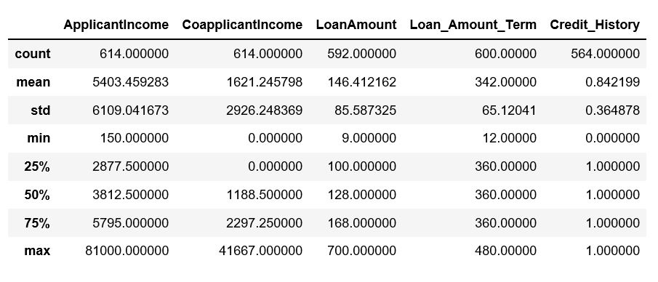
Data set details
Train describe details:
DATA SCIENCE

Slide 9
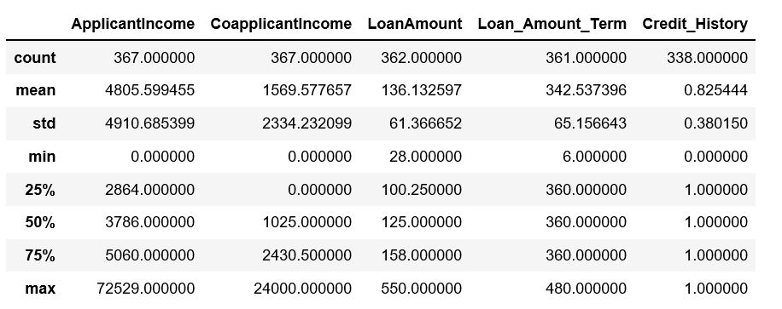
Data set details
Test describe details:
DATA SCIENCE

Slide 10
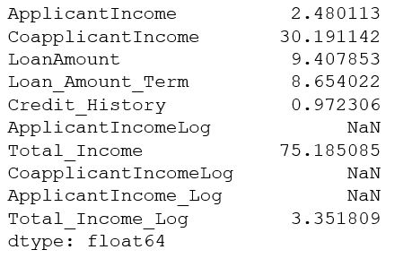
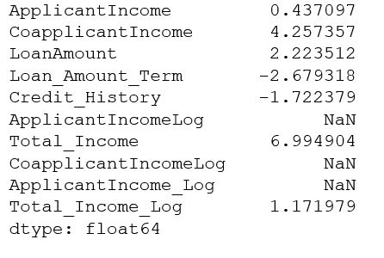
Data set details
Train kurtosis and skewness:
Kurtosis Skew
DATA SCIENCE

Slide 11
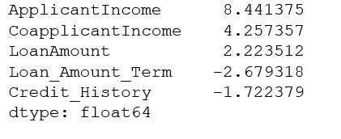
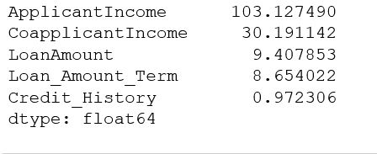
Data set details
Test kurtosis and skewness:
Kurtosis Skew
DATA SCIENCE

Slide 12
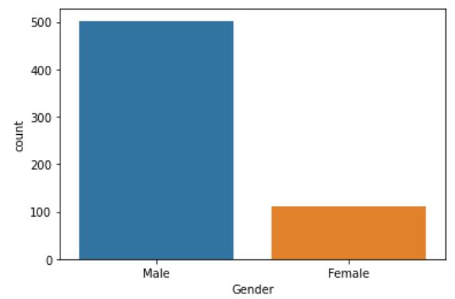
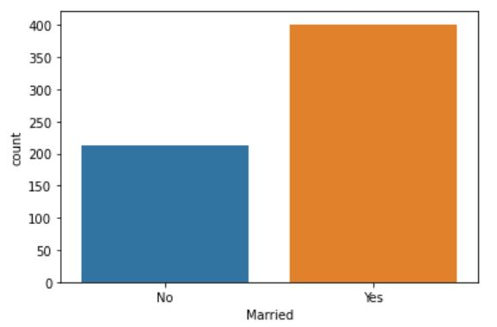
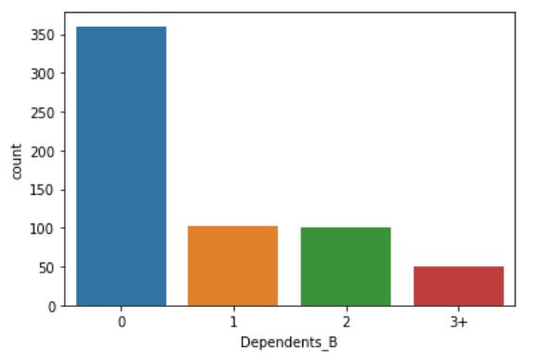
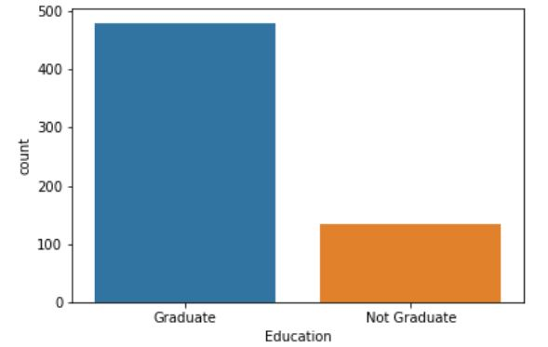
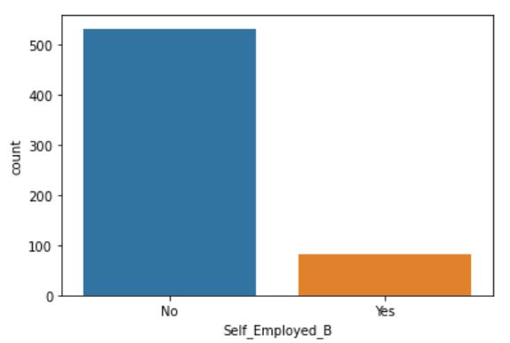
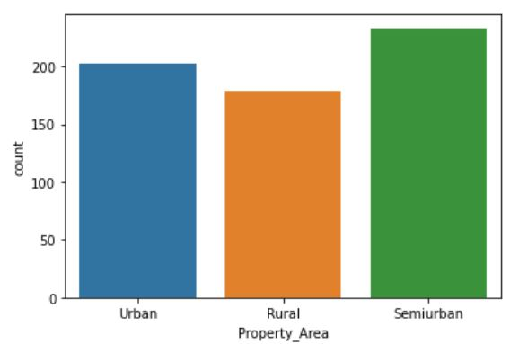
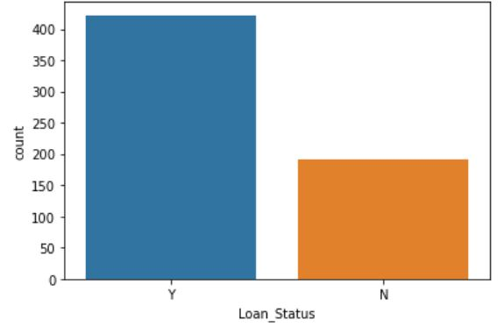
EXPLORATORY DATA ANALYSIS
Categorical attributes visualization:
DATA SCIENCE

Slide 13
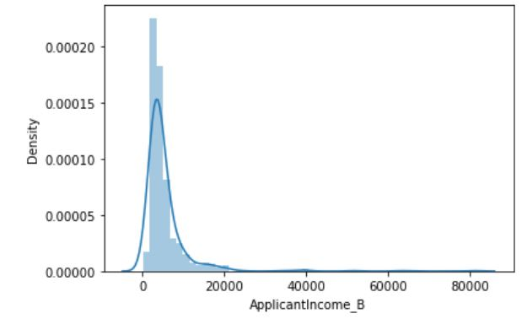
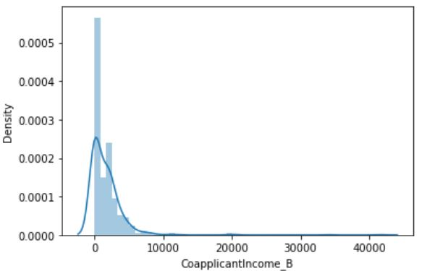
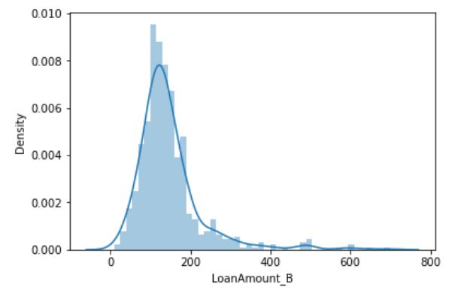
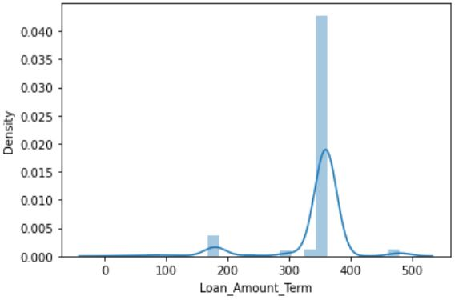
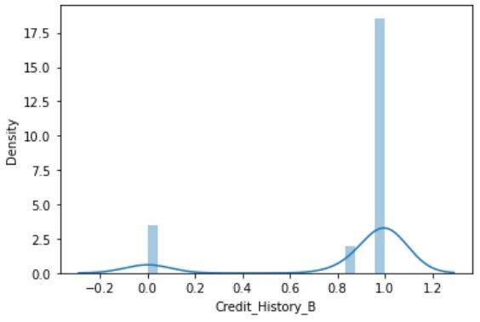
EXPLORATORY DATA ANALYSIS
Numerical attributes visualization:
DATA SCIENCE

Slide 14
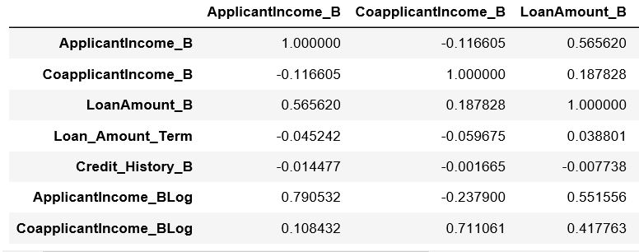
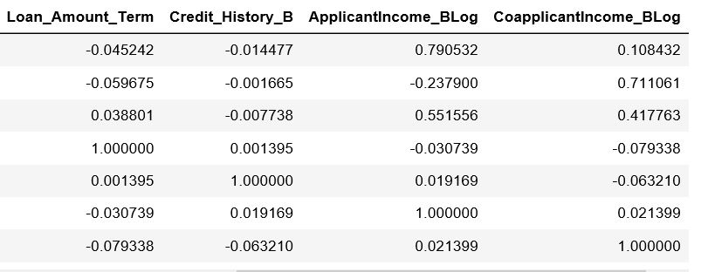
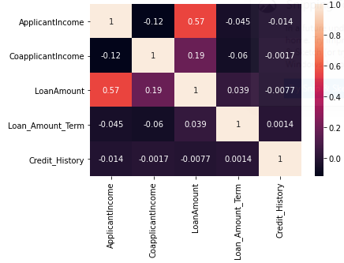
EXPLORATORY DATA ANALYSIS
Correlation Matrix:
DATA SCIENCE

Slide 15
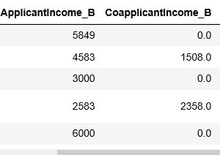
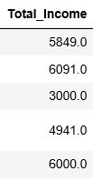
Feature Engineering
Creation of new attributes:
DATA SCIENCE

Slide 16
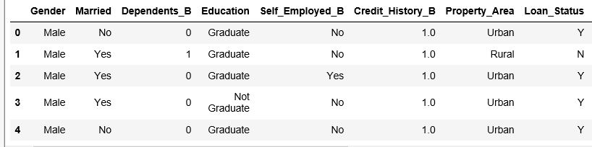
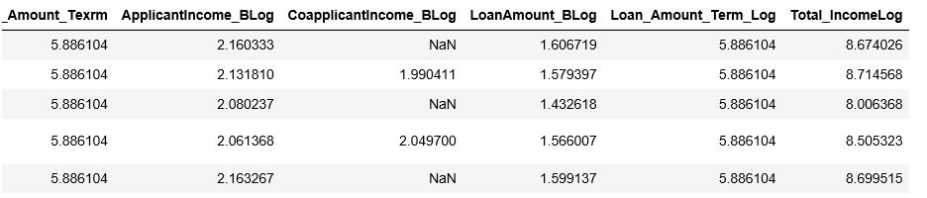
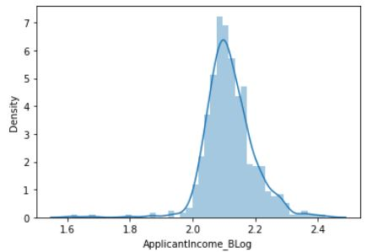
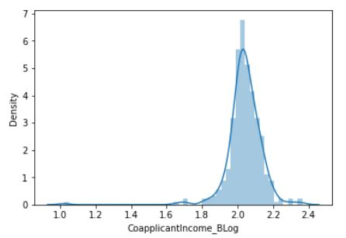
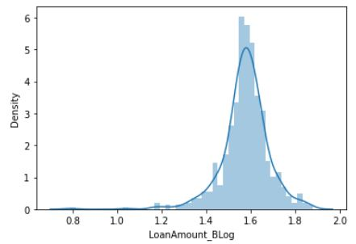
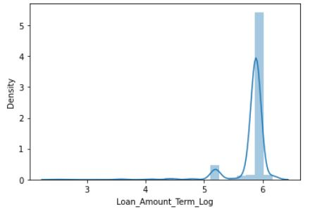
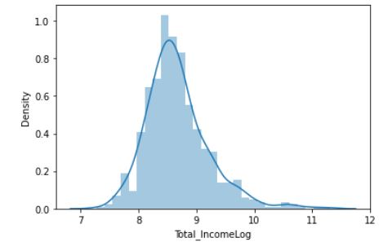
Feature Engineering
Appling Log Tranformations:
DATA SCIENCE

Slide 17
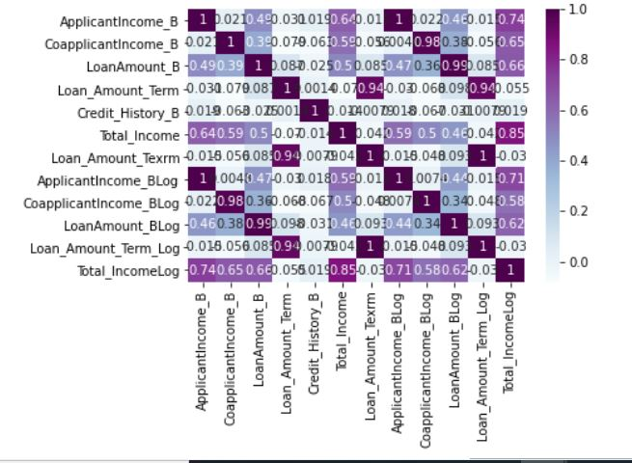
Feature Engineering
Correlation matrix after Log transformation:
DATA SCIENCE

Slide 18
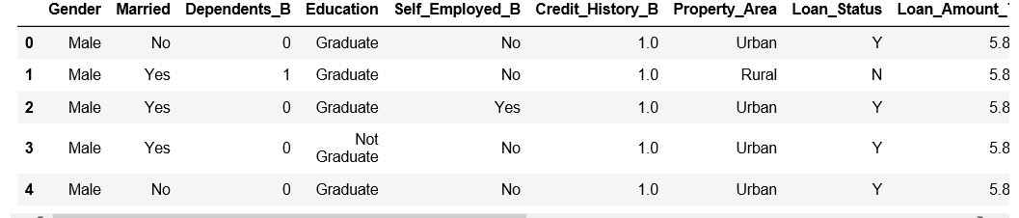
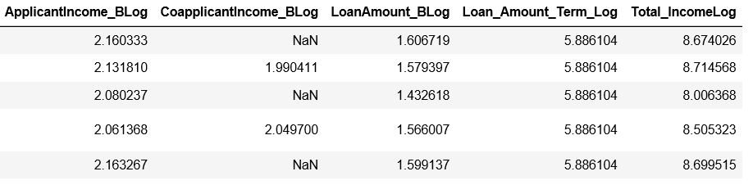
Feature Engineering
Drop unnecessary columns:
DATA SCIENCE

Slide 19
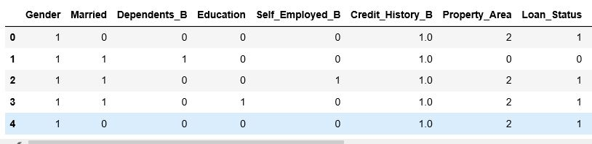
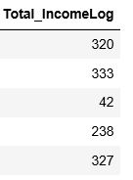
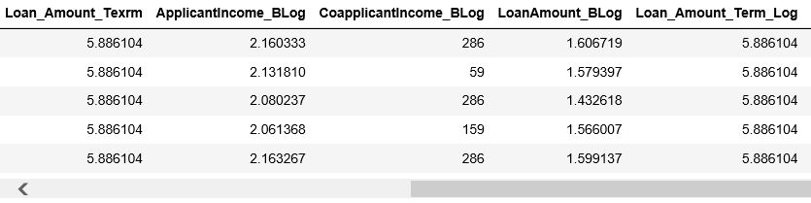
Feature Engineering
Label Encoding:
DATA SCIENCE

Slide 20
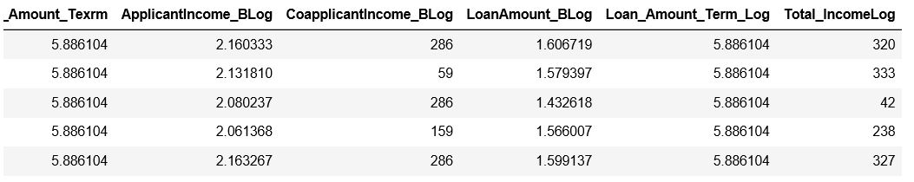
Train-Test Split
Train Data:
DATA SCIENCE

Slide 21
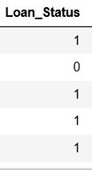
Train-Test Split:
Test Data:
DATA SCIENCE

Slide 22
THANK YOU !

